Slide 1
Using SHAP for DCNN Debugging and Transferability
CSCI 4960
Rebecca Tsekanovskiy

Slide 2
Research Question
How can SHapley Additive exPlanation analysis be used to interpret and debug the predictions of a Deep Convolutional Neural Network model trained on brain cancer scans and tested on lung cancer scans?

Slide 3
Research Objective
To develop and evaluate a deep learning model (Inception V3) for accurate classification of medical images, utilizing SHAP analysis for both interpretability and debugging, with the goal of enhancing the model's ability to generalize and transfer knowledge across different types of tumor scans.

Slide 4
Research Contribution
SHAP transferability
Cross domain generalization
Enhancing medical AI reliability and interpretability

Slide 5
Importance
Impact on healthcare
Increased transparency from debugging = better models = better accuracy = better patient outcomes
Notes:
Improving health care
Directly contributes to patient outcomes
Accurate and early diagnosis
he goal is to develop AI tools that are not just technically impressive but also clinically valuable. The enhancements we’ve made in transparency and accuracy contribute to this larger goal of improving patient care

Slide 6
Terminology
Deep Convolutional Neural Network
Inceptionv3
SHapley Additive exPlanations
Metrics for Evaluation
Notes:
Test and value loss, test and value accuracy

Slide 7
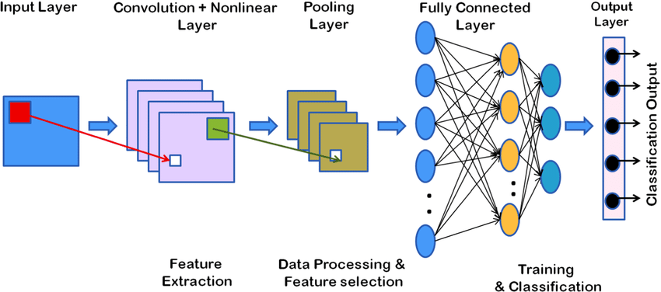
(Deep) Convolutional Neural Network
Artificial intelligence methods for analysis of electrocardiogram signals for cardiac abnormalities: state-of-the-art and future challenges - Scientific Figure on ResearchGate. Available from: https://www.researchgate.net/figure/Deep-convolutional-neural-network-architecture_fig13_351080345
- “Deep” refers to more layers (not pictured)
- Depth for more complex tasks
Notes:
Image enters neural network – input layer receives pixel layer
Extra edges or texture – nonlinear layer like ReLu adds complexity ( can learn more complex patterns)
Pooling layer – reduces complexity size of network
Fully conncted layer – takes all the features learned in prior layers combines and makes final decision

Slide 8
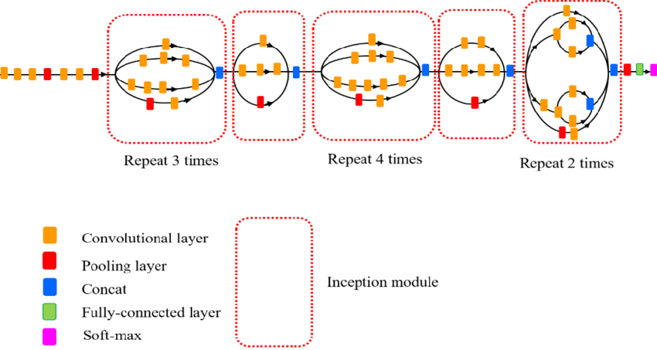
Deep Convolutional Neural Network – Inceptionv3
Figure B DCNN Architecture
Artificial intelligence methods for analysis of electrocardiogram signals for cardiac abnormalities: state-of-the-art and future challenges - Scientific Figure on ResearchGate. Available from: https://www.researchgate.net/figure/Deep-convolutional-neural-network-architecture_fig13_351080345
Feature Detection for Digital Images Using Machine Learning Algorithms and Image Processing - Scientific Figure on ResearchGate. Available from: https://www.researchgate.net/figure/Architecture-for-Inceptionv3-ConvNets-model-In-the-inception-modules-convolutional_fig5_327027035
Figure A Inceptionv3 Architecture
Notes:
Inceptionv3 architecture is deeper and wider (more layers and paths)
: It captures features at multiple scales simultaneously, making it better at identifying complex patterns in images, which is crucial for tasks like medical imaging.
Basic CNN goes through the layers in a more “straight path” manner compared to that of the architecture of Inceptionv3
Convo layer - layer is responsible for detecting features in an image, such as edges, textures, or patterns.
ooling layers reduce the size of the feature maps, making the model more efficient and less likely to overfit. The most common types are max pooling and average pooling. the layer slides a window (usually 2x2) across the feature map and takes the maximum value within that window.
Concat – multiple layers are combined into a single data structure ( tensor ) because the outputs of prior layers are performed in parallel aka same time
Fully connected layer - each neuron is connected to every neuron in the previous layer. It’s used for combining the features extracted by the convolutional layers and making the final decision or classification.
Softmax - the final layer in a classification network. It converts the raw output scores (logits) from the last fully connected layer into probabilities for each class. oftmax is crucial for multi-class classification problems

Slide 9
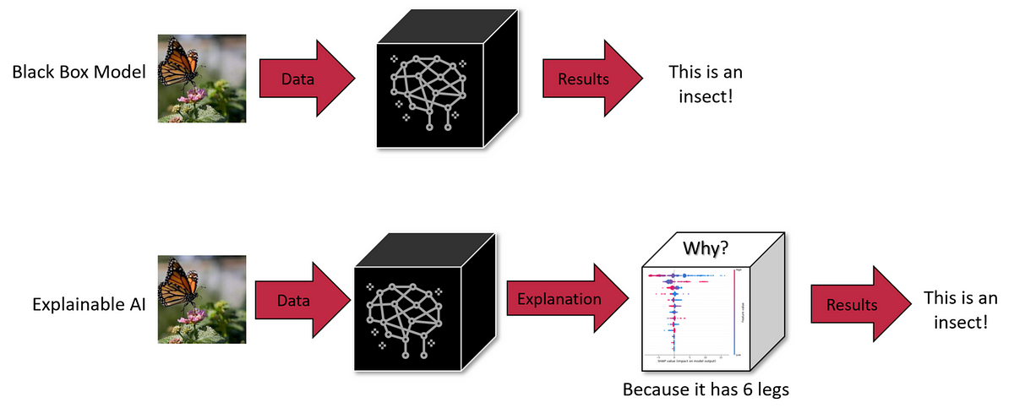
Black Box Model
Simple explanation of a model making a prediction
https://medium.com/advancing-analytics/how-to-explain-your-machine-learning-model-using-shap-449cf05d5160

Slide 10
Shapley Additive exPlanations
https://medium.com/advancing-analytics/how-to-explain-your-machine-learning-model-using-shap-449cf05d5160

Slide 11
Shapley Additive exPlanations
Contributes positively to the model’s prediction
Contributes negatively to the model’s prediction

Slide 12
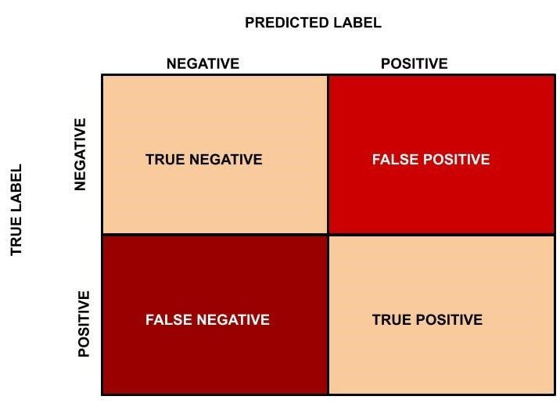
Metrics used for evaluation
True Negative = TN
True Positive = TP
False Negative= FN
False Positive = FP
https://medium.com/analytics-vidhya/confusion-matrix-accuracy-precision-recall-f1-score-ade299cf63cd

Slide 13
Metrics used for evaluation
True Negative = TN
True Positive = TP
False Negative= FN
False Positive = FP
Accuracy = TP + TN
--------------
TP+TN+FP+FN
https://medium.com/analytics-vidhya/confusion-matrix-accuracy-precision-recall-f1-score-ade299cf63cd

Slide 14
Metrics used for evaluation
True Negative = TN
True Positive = TP
False Negative= FN
False Positive = FP
Precision = TP
--------------
TP + FP
https://medium.com/analytics-vidhya/confusion-matrix-accuracy-precision-recall-f1-score-ade299cf63cd

Slide 15
Metrics used for evaluation
True Negative = TN
True Positive = TP
False Negative= FN
False Positive = FP
Recall = TP
--------------
TP + FN
https://medium.com/analytics-vidhya/confusion-matrix-accuracy-precision-recall-f1-score-ade299cf63cd

Slide 16
Metrics used for evaluation
True Negative = TN
True Positive = TP
False Negative= FN
False Positive = FP
F1 Score = 2 * Precision * Recall
--------------
Precision + Recall
https://medium.com/analytics-vidhya/confusion-matrix-accuracy-precision-recall-f1-score-ade299cf63cd

Slide 18
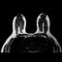
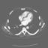
Chest and Stomach Scans
10,000 chest scans, 10,000 stomach scans
Proof of concept
https://www.kaggle.com/datasets/andrewmvd/medical-mnist

Slide 19
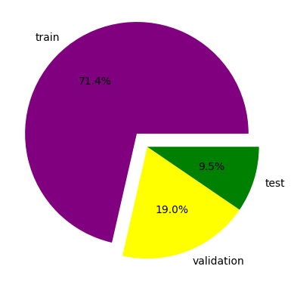
Chest and Stomach Scans

Slide 20
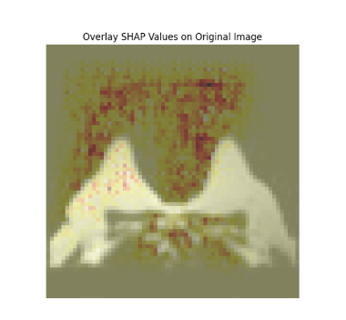
SHAP – Chest scan
Transferability was not tested
Identifying what the model is focusing on

Slide 21
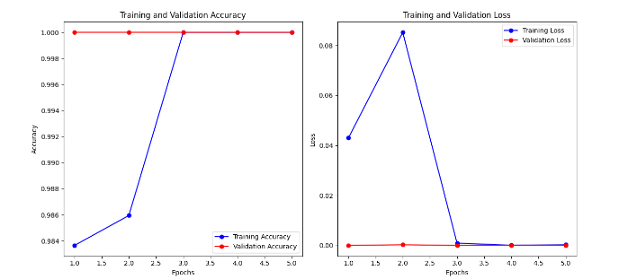
Chest and Stomach

Slide 23
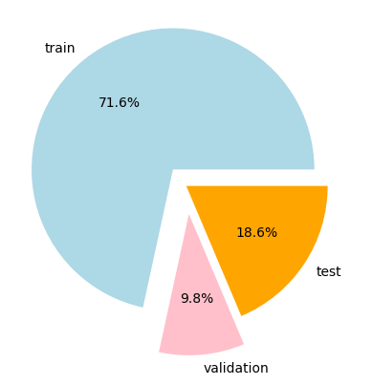
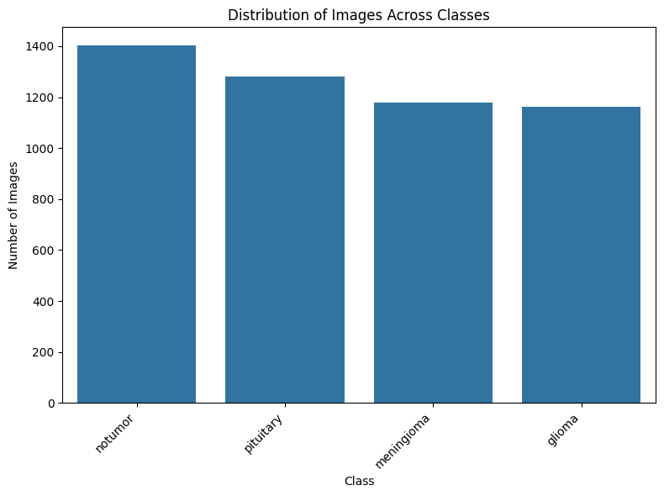
Brain Scans
Training class only
Figure A
Figure B

Slide 24
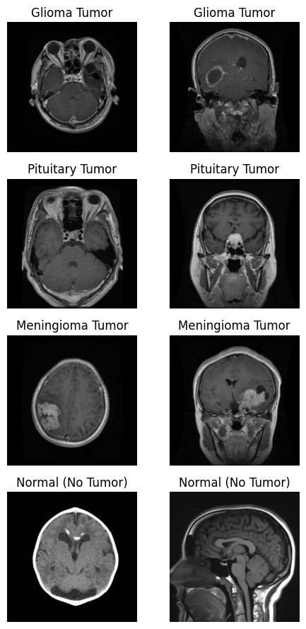
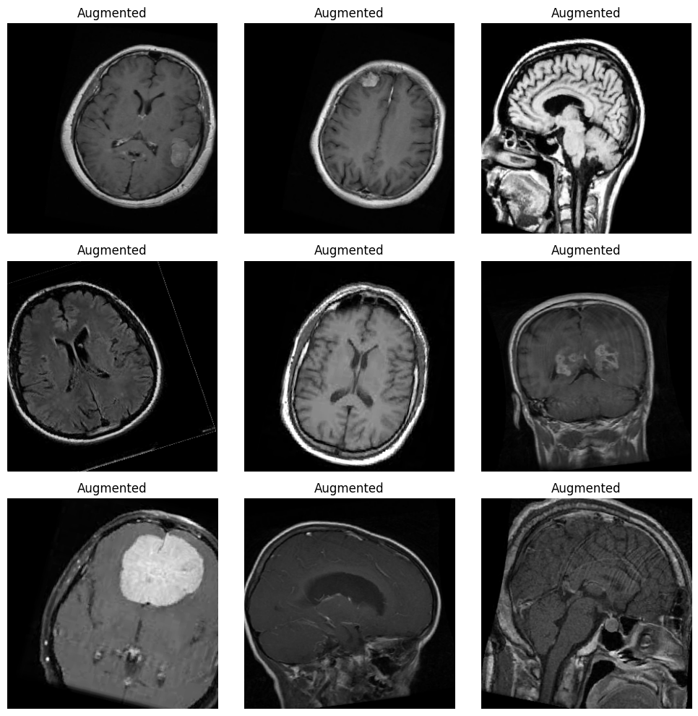
Brain Scans
Figure A
Figure B

Slide 25
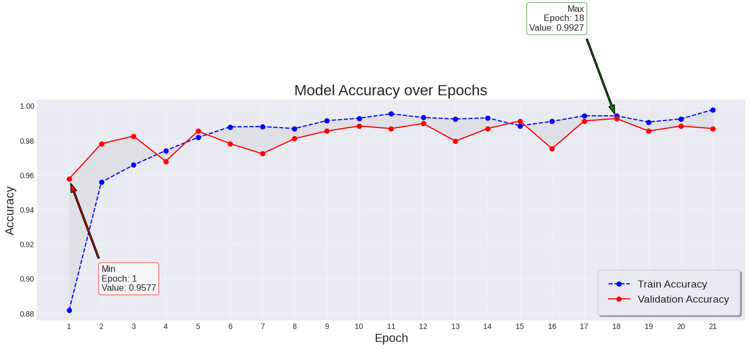
Model Results trained on Brain Scans

Slide 26
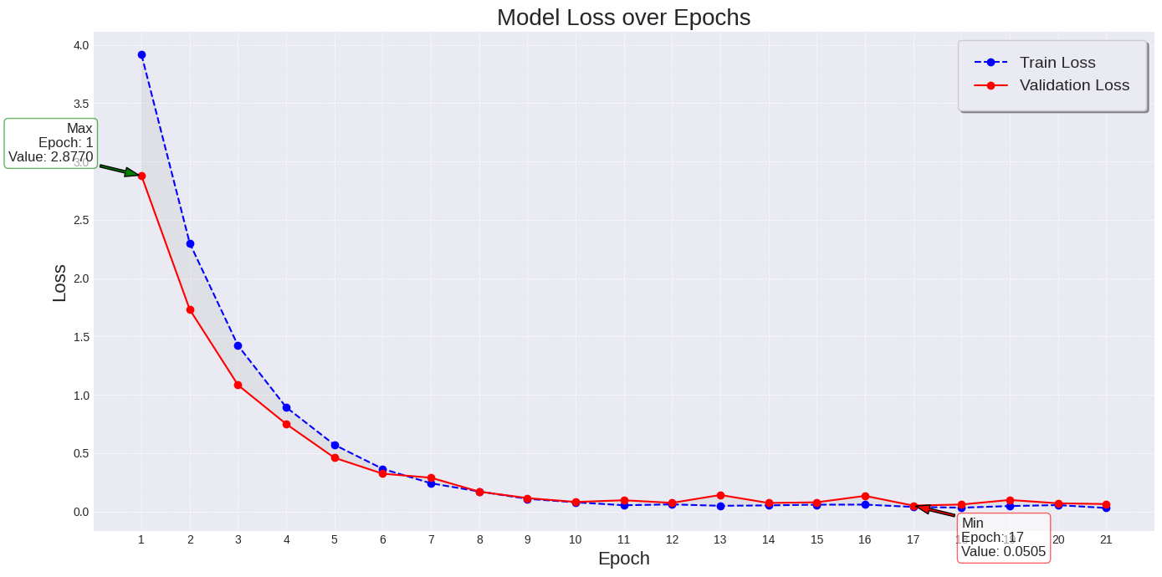
Model Results trained on Brain Scans

Slide 27
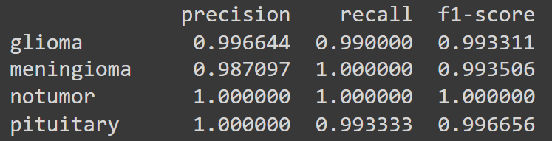
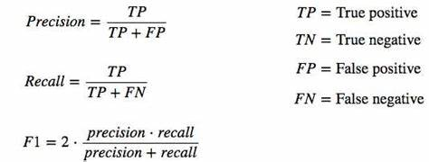
Model Results trained on Brain Scans
https://jonathan-hui.medium.com/map-mean-average-precision-for-object-detection-45c121a31173

Slide 28
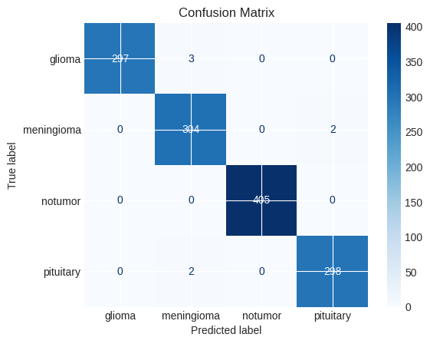
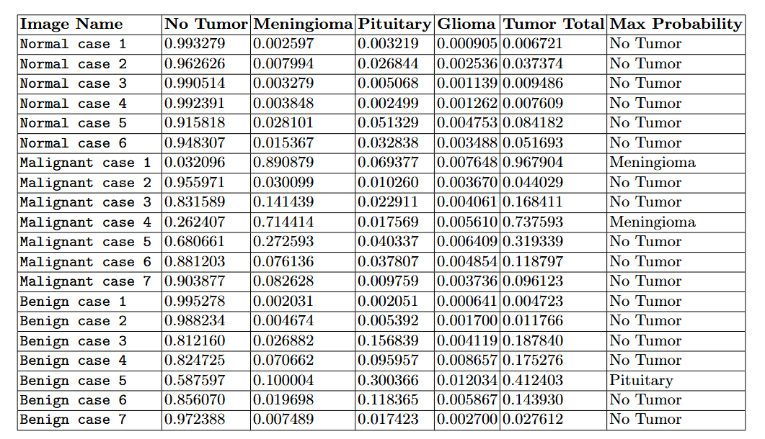
Model Results trained on Brain Scans

Slide 29
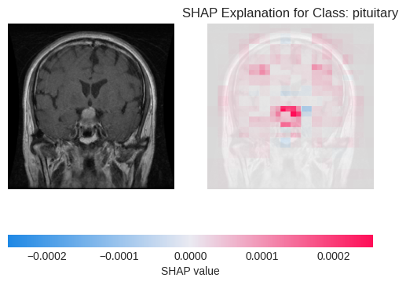
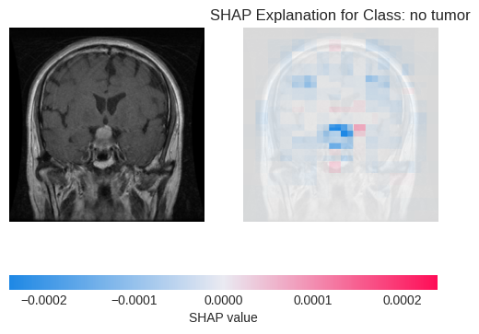
Brain Scan Evaluation ( Pituitary)
Figure B
Figure A

Slide 30
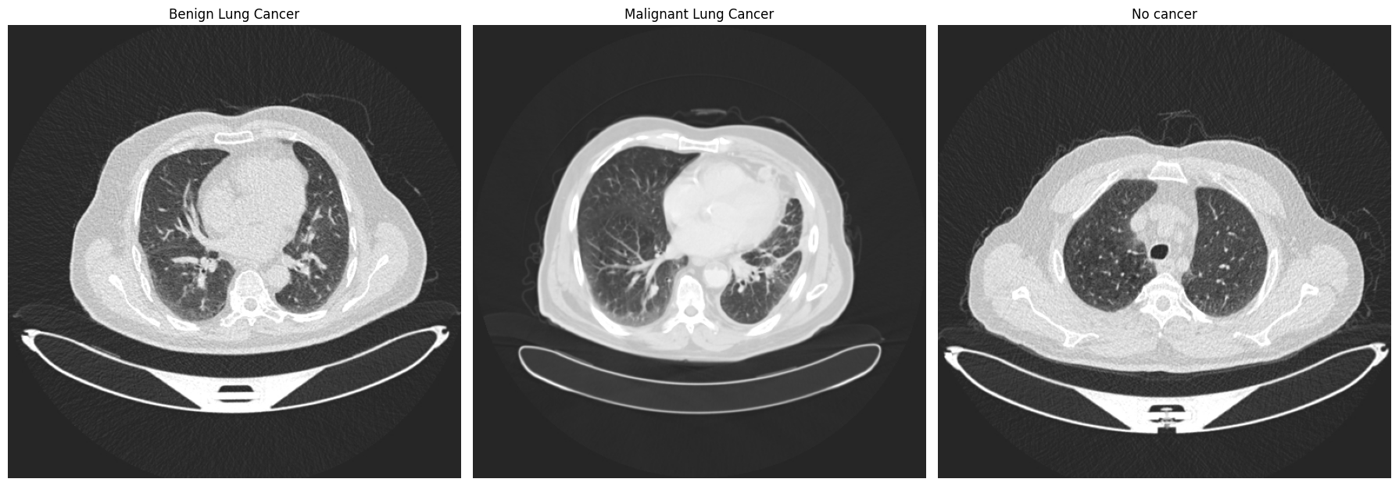
Lung Scans

Slide 31
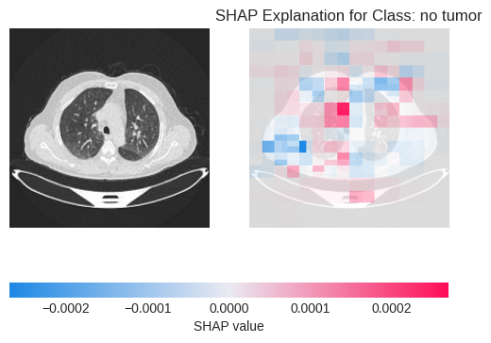
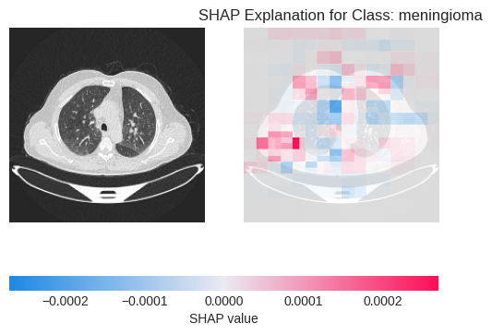
Normal lung Scan
Figure A
Figure B
Probabilities are .91581779, .05132906

Slide 32
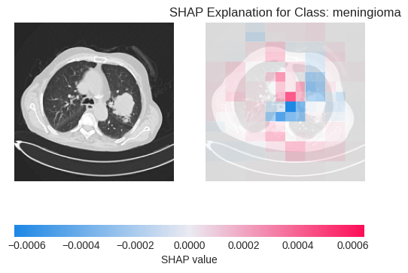
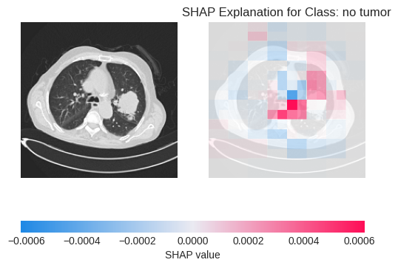
Malignant Case
Figure A
Figure B
Probabilities are . 8315888 , .14143935

Slide 33
Lung Cancer Results

Slide 34
Conclusion
The model can detect differences in tumor scans, but it struggles with accurately transferring this knowledge to other types of scans, indicating a limitation in its generalizability.

Slide 35
Future Work
Expand the dataset to include other types of cancer, train the model , and see if the generalization improves
Expand the dataset to include stages of cancer and have the model predict type of tumor and stage of cancer.

Slide 36
Future Work
Use a faster GPU and increase the complexity of my model
Work with other forms of explainable ai (XAI) to see if different conclusions can be made

Slide 37
Contributions
Special thank you to my peers, teaching assistants of CSCI 4960, and Neha Keshan!

